Slide 1
Scheduling
Covers Chapter#09 from Textbook

Slide 2
First-Come-First-Served
The simplest scheduling policy is first-come-first-served (FCFS), also known as first-in-first-out (FIFO) or a strict queuing scheme.
As each process becomes ready, it joins the ready queue.
When the currently running process ceases to execute, the process that has been in ready queue the longest is selected for running.

Slide 3

First-Come-First-Served (Cont.)
Consider the following example for FCFS.
Given in this example is Arrival Time and Service Time ($T_{s}$).

Slide 4
First-Come-First-Served (Cont.)
In the previous example:
Normalized turnaround time for process Y is way out of line compared to the other processes. The total time that it is in the system is 100 times the required processing time. This happens whenever a short process arrives just after a long process.
Long processes do not fare poorly. Process Z has a turnaround time that is almost double that of Y, but its normalized residence time is under 2.0.

Slide 5
First-Come-First-Served (Cont.)

Slide 6
First-Come-First-Served (Cont.)
General characteristics of FCFS:
FCFS performs much better for long processes than short ones.
FCFS tends to favor processor-bound processes over I/O-bound processes.
FCFS is not an attractive alternative on its own for a uniprocessor system.
However, it is often combined with a priority scheme to provide an effective scheduler.
Thus, the scheduler may maintain a number of queues, one for each priority level, and dispatch within each queue on a first-come-first-served basis.

Slide 7
Round Robin (RR)
To reduce the penalty that short jobs suffer with FCFS is to use preemption based on a clock, i.e. a clock interrupt is generated at periodic intervals.
Round robin uses the above described technique.
When interrupt occurs, currently running process is placed in ready queue, and next ready job is selected on a FCFS basis.
This technique is also known as time slicing, because each process is given a slice of time before being preempted.
In round robin, the principal design issue is length of the time quantum, or slice, to be used.

Slide 8
Round Robin: Time Quantum
If quantum is very short, then short processes will move through the system relatively quickly.
There is processing overhead involved in handling the clock interrupt and performing the scheduling and dispatching function. Thus, very short time quanta should be avoided.
For time quantum slightly greater than the time required for a typical interaction or process function. If it is less, then most processes will require at least two time quanta.
For the case of a time quantum longer than the longest running process, round robin degenerates to FCFS.

Slide 11
Shortest Process Next
Shortest Process Next (SPN) is a non-preemptive policy.
In SPN, the process with the shortest expected processing time is selected next.
A short process will jump to the head of the queue past longer jobs.
Performance is improved in terms of response time, but variability of response times is increased especially for longer processes.

Slide 12
Shortest Process Next (Cont.)

Slide 13
Shortest Remaining Time
The shortest remaining time (SRT) policy is a preemptive version of SPN.
The scheduler always chooses the process that has the shortest expected remaining processing time.
When a new process joins the ready queue, it may have a shorter remaining time than the currently running process. Accordingly, the scheduler may preempt the current process when a new process becomes ready.
There is a risk of starvation of longer processes.

Slide 14
Shortest Remaining Time (Cont.)

Slide 15
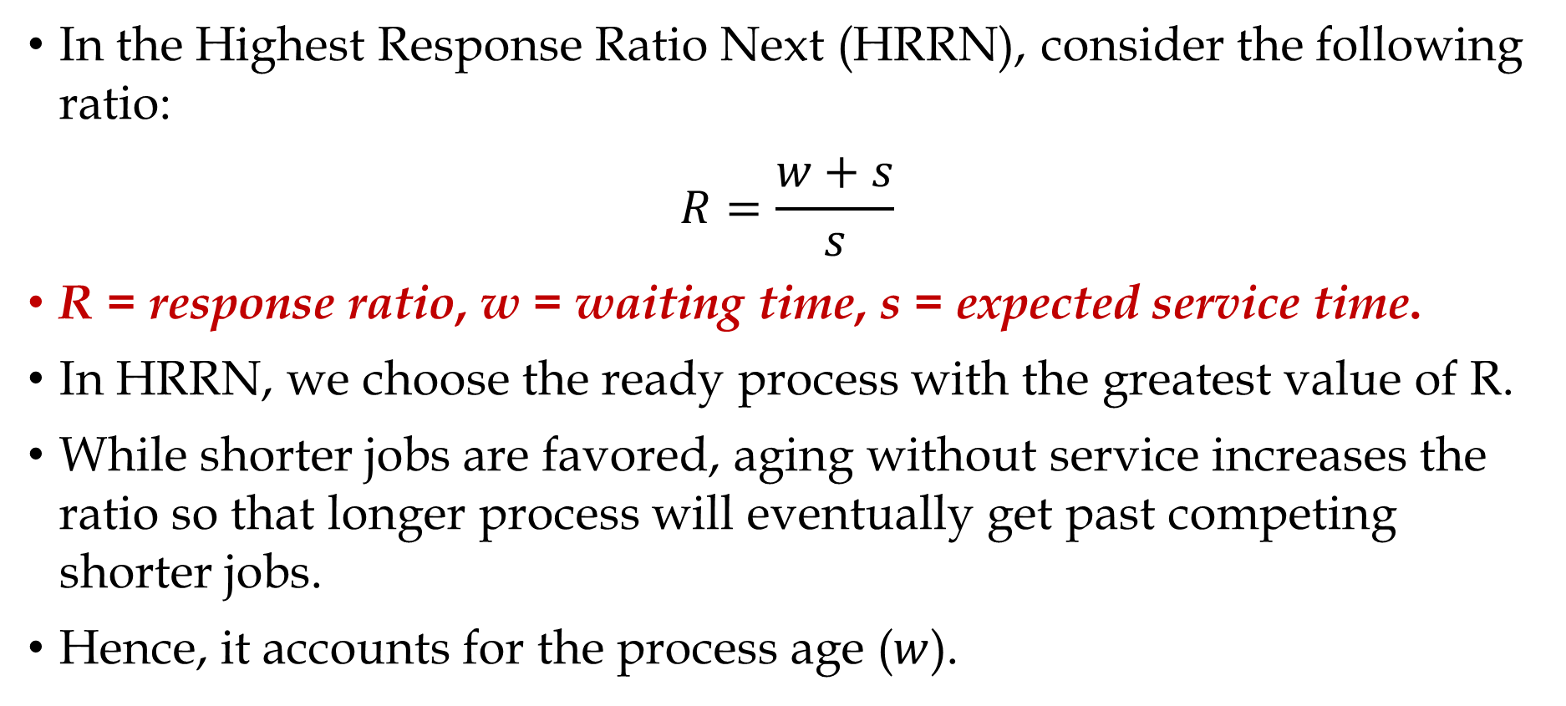
Highest Response Ratio Next
In the Highest Response Ratio Next (HRRN), consider the following ratio:
$$R=\frac{w+s}{s}$$
R = response ratio, w = waiting time, s = expected service time.
In HRRN, we choose the ready process with the greatest value of R.
While shorter jobs are favored, aging without service increases the ratio so that longer process will eventually get past competing shorter jobs.
Hence, it accounts for the process age ($w$).

Slide 16
Highest Response Ratio Next (Cont.)

Slide 17
Service Time Estimation
In general, we cannot know ahead of time what the service time is going to be. However, we can approximate it, either based on past history or some input from the user or a configuration manager.
In SRT, SPN and HRRN, the expected service time must be estimated.

Slide 18
Multilevel Feedback
Another way of establishing a preference for shorter jobs is to penalize jobs that have been running longer.
The multilevel feedback focus on the time spent in execution so far.
Scheduling is done on a preemptive basis, and a dynamic priority mechanism is used.
When a process first enters the system, it is placed in RQ0.
After its first preemption, when it returns to the Ready state, it is placed in RQ1.
Each subsequent time that it is preempted, it is demoted to the next lower-priority queue.
Within each queue, a simple FCFS mechanism is used. Except the lowest-priority queue where round-robin is used.

Slide 20
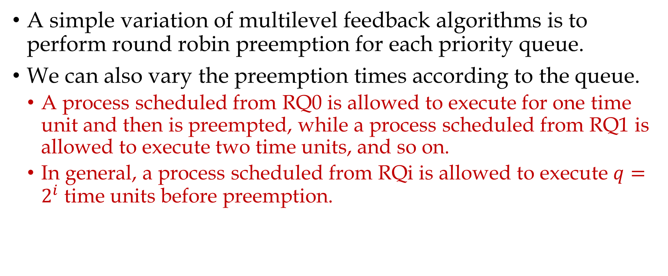
Multilevel Feedback Variation
A simple variation of multilevel feedback algorithms is to perform round robin preemption for each priority queue.
We can also vary the preemption times according to the queue.
A process scheduled from RQ0 is allowed to execute for one time unit and then is preempted, while a process scheduled from RQ1 is allowed to execute two time units, and so on.
In general, a process scheduled from RQi is allowed to execute $q=2^{i}$ time units before preemption.

Slide 21
Table 9.3:
Characteristics of Various Scheduling Policies

Slide 22
Thank You!

